Slide 1
Lending Club Case Study
Presentation Submitted By: Vishal Verma

Slide 2
Problem Statement
On loan data set is to aim is to identify patterns which indicate if a person is likely to default, which may be used for taking actions such as denying the loan, reducing the amount of loan, lending (to risky applicants) at a higher interest rate, etc.

Slide 3
Steps Taken Care While Analysis
Understand Data Dictionary
Understand Data
Loading Data Set
Finding and remove missing values
Find Categorical and Numerical Variables
Label Encoding
Finding Outlier
Perform Univariate & Bivariate Analysis
Conclusion on Result

Slide 4
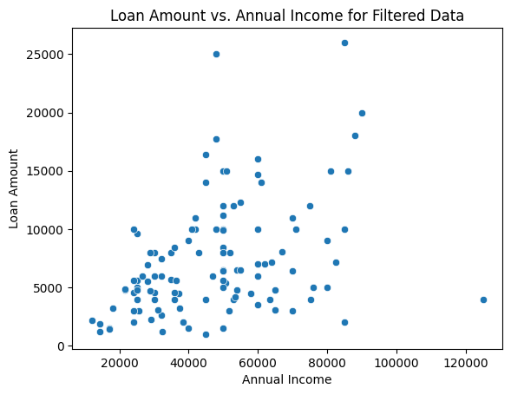
Bivariate Analysis Result
Graphical Representation of Result
Condition
Compare loan amount vs annual income If person home ownership is Rent, Emp length less than 3, fall under grade C, Payment plan is No, and delinquency in the borrower's credit file for the past 2 years.
In the right side of graph generated based on the above conditions and can identify person is likely to default

Slide 5
Thank You!

